Slide 1





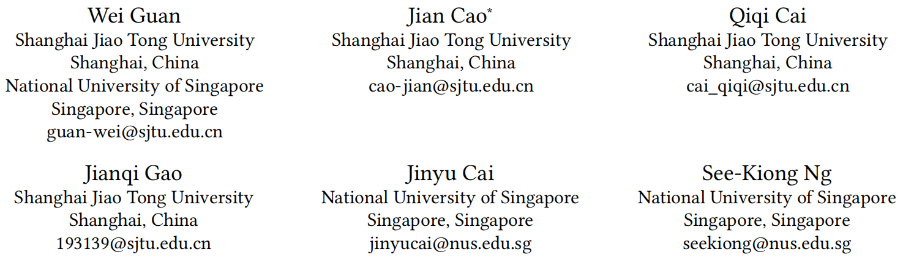





ATAI
Advanced Techniqueof Artificial Intelligence
ATAI
ChongqingUniversity _{AdvancedTechniqueof}
of Technology Artificial Intelligence
Chongqing University of
Technology
Chongqing University ^{ATAI}
_{of Technology} Advanced Techniqueof
Artificial Intelligence
Chongqing University of Technology
Chongqing University of Technology
SEAR：LLM-Powered Sequential Recommendation via Fusion of Collaborative, Semantic, and Rating Information
Code: https://github.com/guanwei49/SEAR.
2026.4.29
—— WWW_2026
Reported by Yang Hu
1

Slide 2

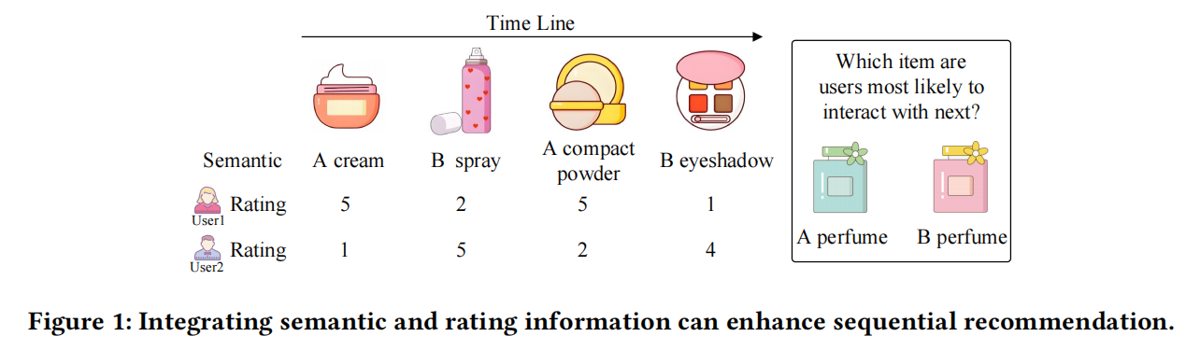
ATAI
AdvancedTechniqueof
Artificial Intelligence
ATAI
ChongqingUniversity _{AdvancedTechniqueof}
of Technology Artificial Intelligence
ChongqingUniversity of Technology
Motivation
Existing methods for sequential recommendation face two key challenges:
1.they struggle to simultaneously leverage collaborative, semantic, and rating information,
2.and the use of hard labels during training provides limited supervision

Slide 3

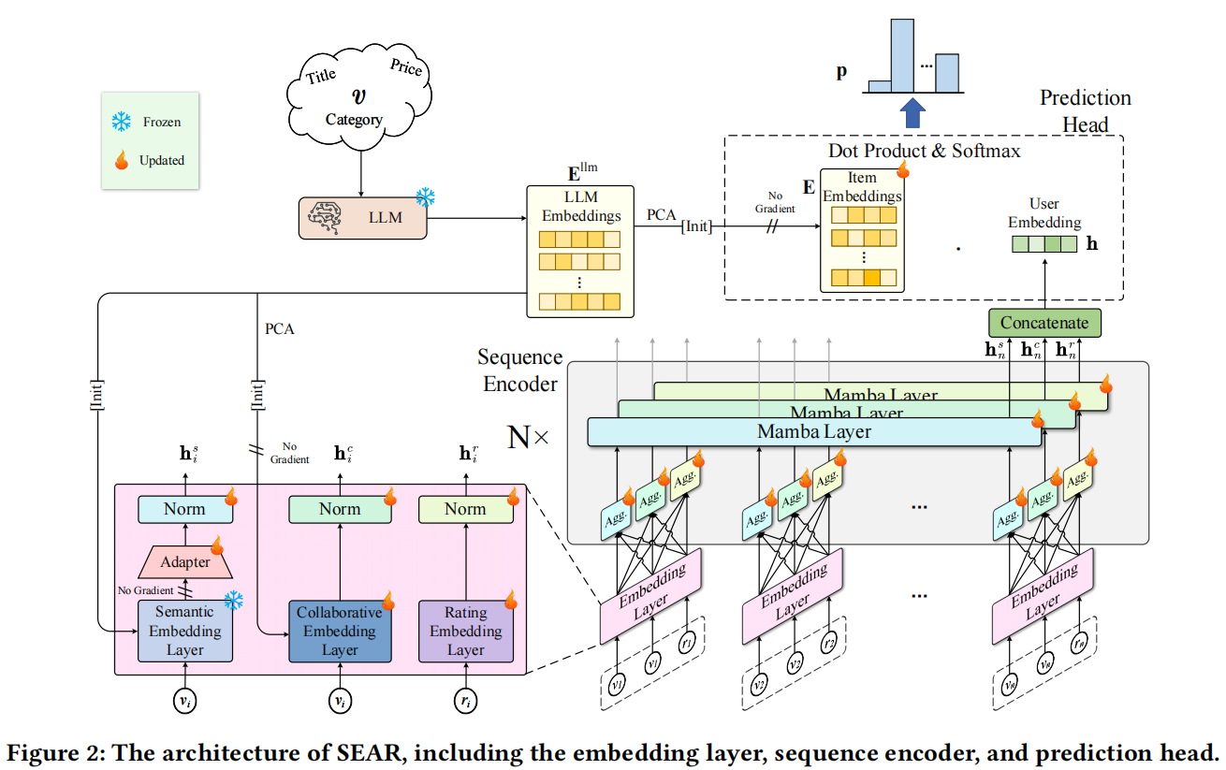
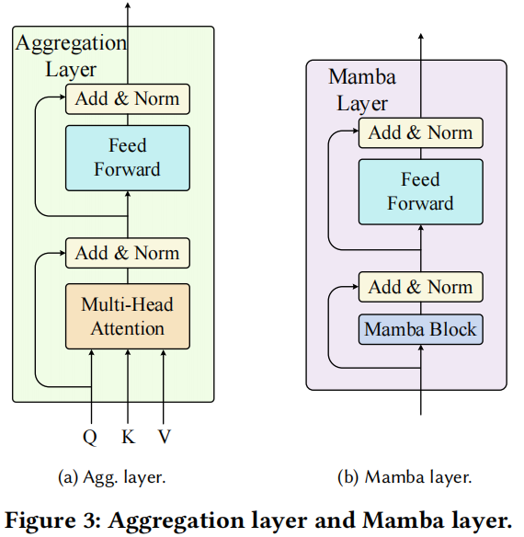
ChongqingUniversity of Technology
ATAI
AdvancedTechniqueof
Artificial Intelligence
ATAI
ChongqingUniversity _{AdvancedTechniqueof}
of Technology Artificial Intelligence
Overview

Slide 4
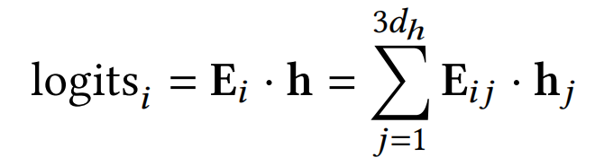
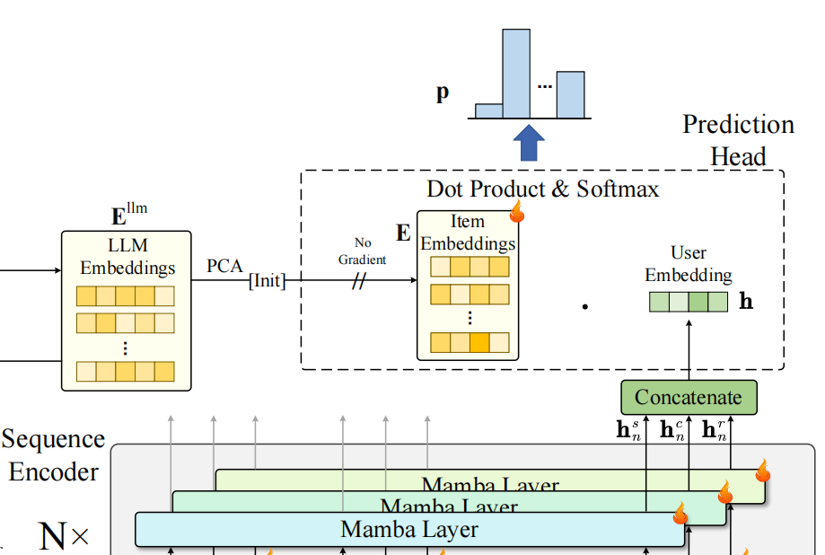
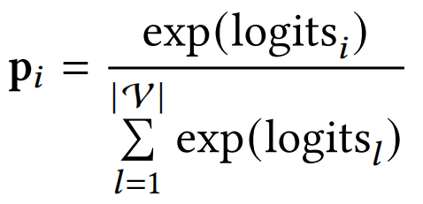
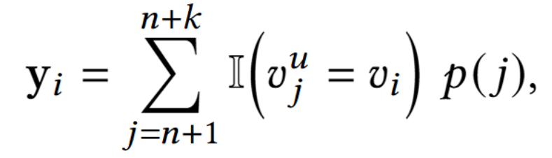
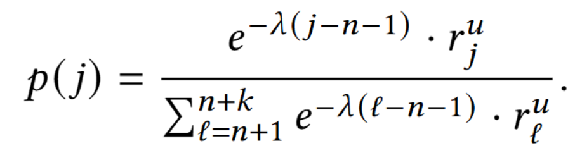
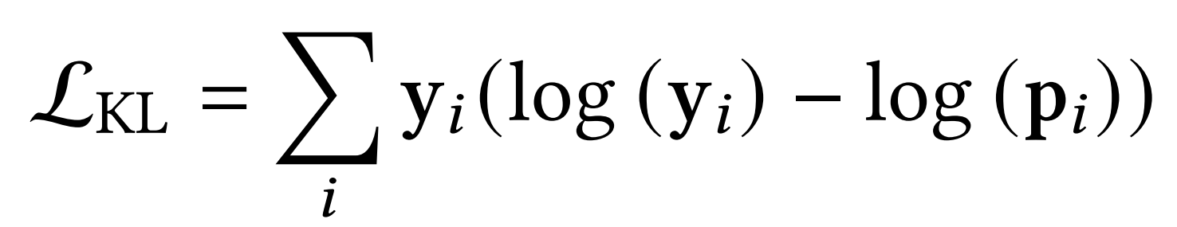
ChongqingUniversity of Technology
ATAI
AdvancedTechniqueof
Artificial Intelligence
ATAI
ChongqingUniversity _{AdvancedTechniqueof}
of Technology Artificial Intelligence
Method
(1)
(2)
(3)
(4)
(5)

Slide 5

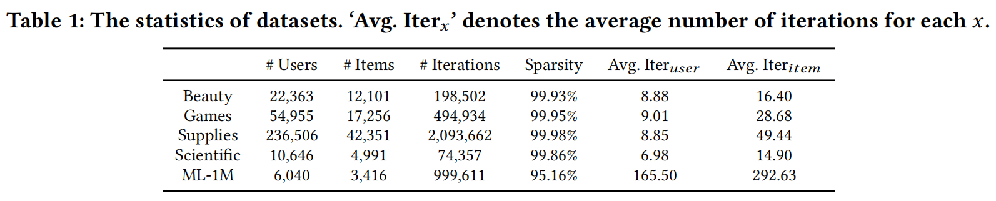
ATAI
AdvancedTechniqueof
Artificial Intelligence
ATAI
ChongqingUniversity _{AdvancedTechniqueof}
of Technology Artificial Intelligence
ChongqingUniversity of Technology
Experiments

Slide 6
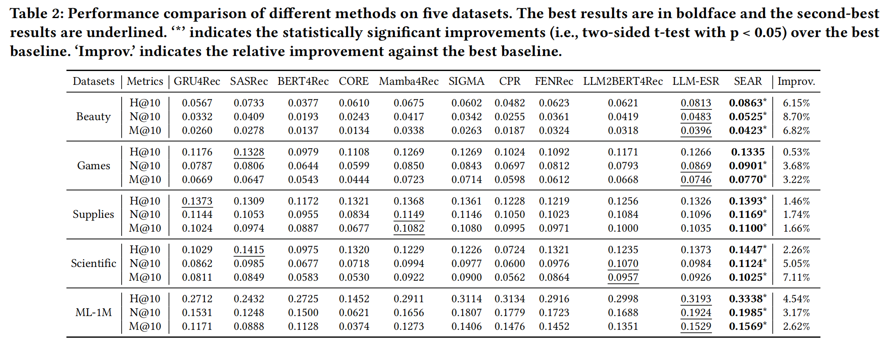
ATAI
AdvancedTechniqueof
Artificial Intelligence
ATAI
ChongqingUniversity _{AdvancedTechniqueof}
of Technology Artificial Intelligence
ChongqingUniversity of Technology
Experiments

Slide 7
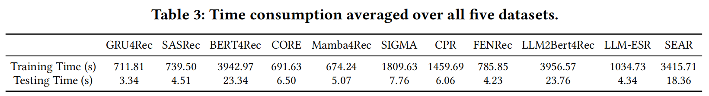
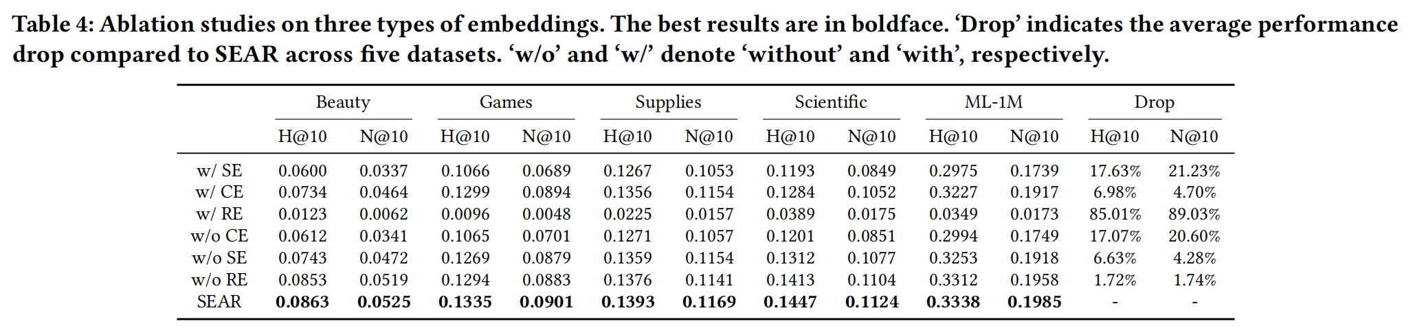
ATAI
AdvancedTechniqueof
Artificial Intelligence
ATAI
ChongqingUniversity _{AdvancedTechniqueof}
of Technology Artificial Intelligence
ChongqingUniversity of Technology
Experiments

Slide 8
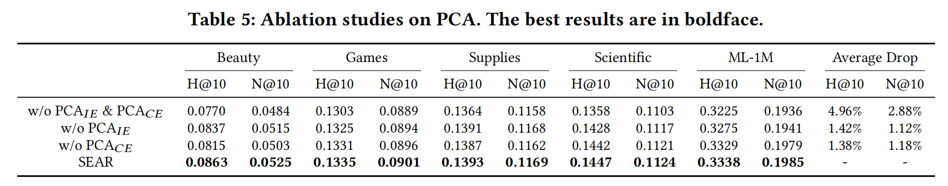
ATAI
AdvancedTechniqueof
Artificial Intelligence
ATAI
ChongqingUniversity _{AdvancedTechniqueof}
of Technology Artificial Intelligence
ChongqingUniversity of Technology
Experiments

Slide 9
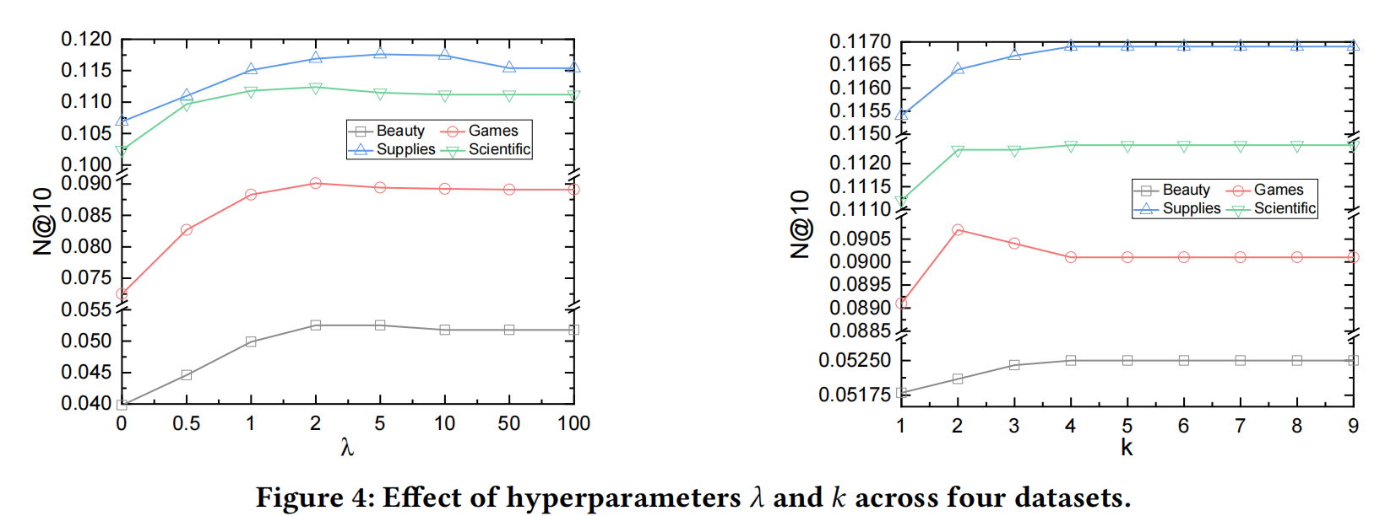
ATAI
AdvancedTechniqueof
Artificial Intelligence
ATAI
ChongqingUniversity _{AdvancedTechniqueof}
of Technology Artificial Intelligence
ChongqingUniversity of Technology
Experiments

Slide 10
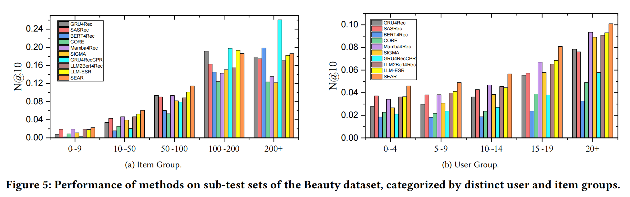
ATAI
AdvancedTechniqueof
Artificial Intelligence
ATAI
ChongqingUniversity _{AdvancedTechniqueof}
of Technology Artificial Intelligence
ChongqingUniversity of Technology
Experiments

Slide 11


ChongqingUniversity of Technology
ATAI
AdvancedTechniqueof
Artificial Intelligence
ATAI
ChongqingUniversity _{AdvancedTechniqueof}
of Technology Artificial Intelligence
Thanks!

